Slide 2
Reconnect Program Briefing
United States Department of Agriculture, Rural Development: West Virginia Project Teams
January 9, 2019
1.
ReConnect Program Summary
$600 million in available funds to improve broadband service in rural unserved areas.
Program offers:
Grants
Loans
Grant-Loan Combinations
Application deadlines begin in April 2019.
Notes:
The U.S. Department of Agriculture (USDA) Rural Development announced in December 2018 a funding opportunity for a new program created under the Consolidated Appropriations Act of 2018, the ReConnect Program. This program will offer grants, loans, and grant-loan combinations to improve broadband service in rural unserved areas from a pool of $600 million in available funds.
The West Virginia Broadband Enhancement Council (WVBEC) seeks to support applications for projects in West Virginia to this important new program. Application deadlines will begin in April 2019. Visit broadband.wv.gov for more information or send email to WVBroadbandCouncil@wv.gov.

Slide 3
Official Information About the ReConnect Program
2.
The WVBEC stands ready to assist potential applicants obtain the information that they need from USDA. Visit broadband.wv.gov for more information or send email to WVBroadbandCouncil@wv.gov.
Note: Applicants should review the materials published by the USDA at reconnect.usda.gov. In the event of any discrepancy, the USDA information will prevail.

Slide 4
Eligible Applicants
3.
A wide range of entities can apply for ReConnect Program funding, including:
Cooperatives, non-profits, or mutual associations
For-profit corporations or limited liability companies
States, local governments, or any agency, subdivision, instrumentality, or political subdivision thereof
A territory or possession of the U.S.
An Indian tribe
An applicant must be able to provide retail broadband service to customers.

Slide 5
Eligible Costs
4.
The construction or improvement of facilities, including buildings and land, required to provide broadband service.
Pre-application expenses (not to exceed 5% of the total award). Costs must be incurred after the publication date of the FOA and be properly documented.
For 100% loans only – The acquisition of an existing system that does not currently provide sufficient access to broadband (limited to 40% of the total loan amount).
Terrestrial-based facilities for satellite broadband service.
Costs must be reasonable, allocable, and necessary.
Applications that propose to use any portion of the award or matching funds for any ineligible cost may be rejected.

Slide 6
Types of ReConnect Applications
5.
The ReConnect Program has three separate funding categories:
100%Grant: Deadline April 29, 2019
50% - 50% Grant-Loan Combination: Deadline May 29, 2019
100% Loan: Open through June 28, 2019
Applicants may submit only one application to the program in this funding opportunity, in only one of the three categories.
In each category, USDA announced that up to $200 million will be available. Maximum awards are:
$25 million for a Grant,
$50 million for Grant-Loan Combination, and
$50 million for Loan

Slide 7
Areas in West Virginia Eligible for Funding
6.
Applicants will be responsible for defining one or more Proposed Service Areas (PFSA(s)) in their application.
Eligible areas include “any area that is not located in a city, town, or incorporated area that has a population of greater than 20,000 inhabitants or an urbanized area contiguous and adjacent to a city or town that has a population of greater than 50,000 inhabitants.”
Notes:
Note: CDBG funds are considered Federal grants. However, CDBG funds may be recognized as matching funds to other Federal funding sources in most circumstances.
Funding for service areas of CAF II recipients can only be requested by the entity that is receiving the CAF II support, and such funding is limited to a 100% loan.

Slide 8
Areas in West Virginia Eligible for Funding
6.
The ReConnect Program will fund projects in rural areas without sufficient access to broadband, defined by USDA as 10 Mbps downstream and 1 Mbps upstream (10:1 service).
The USDA has not prescribed a method that applicants must use to determine whether a PFSA lacks 10:1 service. The USDA will use a variety of methods to validate that PFSA lack sufficient access to broadband.
Certain limitations on who may apply or under what category may apply in areas that previously received awards of USDA broadband grants or loans, state broadband grants, or areas in which the FCC made awards under the Connect America Phase II Auction.
Notes:
Note: CDBG funds are considered Federal grants. However, CDBG funds may be recognized as matching funds to other Federal funding sources in most circumstances.
Funding for service areas of CAF II recipients can only be requested by the entity that is receiving the CAF II support, and such funding is limited to a 100% loan.

Slide 9
Eligibility Factors
7.
Audited Financial Statement
Full and Complete Application
Timely Buildout Completion
Technical Feasibility
Service Areas
Fully Funded
Financial Feasibility and Sustainability

Slide 10
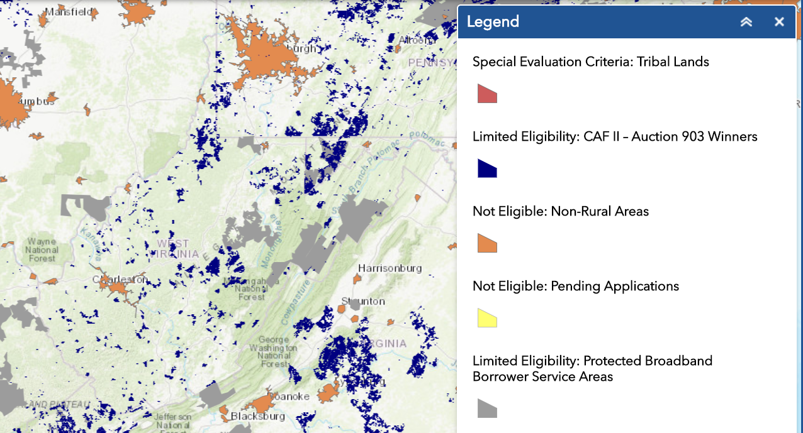
Mapping Assistance
8.
WVBEC will assist possible applicants in identifying potentially eligible areas within West Virginia. The USDA interactive mapping tool is available at: https://reconnect.usda.gov/s/rd-rdae-mapping-tool, providing the following information:
CAF II Winners
Non-Rural Areas
Pending Applications
Protected Broadband Borrower Service Areas
Special Evaluation Criteria, such as community facilities, health care facilities and educational facilities.
For unserved areas, start with the FCC's Broadband Deployment Map (broadbandmap.fcc.gov/#/). Supplement with additional specific, granular, documentable information about unserved areas.
Notes:
The WVBEC has participated in broadband mapping efforts, including analysis of federal broadband mapping data and collection of broadband speed test data.
The FCC's Broadband Deployment Map, in combination with the mapping tool published on the ReConnect Program websites are good starting places for identifying potentially eligible areas (broadbandmap.fcc.gov/#/). Because FCC data is known to contain some inaccuracies, including overstating the extent of broadband coverage in some areas, applicants who have specific, granular, documentable information about areas that lack 10:1 service are encouraged to use that information as well.

Slide 11
Speed Requirements for Funded Projects
9.
Applicants must propose to build a network that is capable of providing service to every household, farm, and business in the Proposed Funded Service Area at a speed of 25 Mbps downstream and 3 Mbps upstream.
Under the 50% loan / 50% grant and 100% grant categories, projects that are proposing to build a network capable of providing at least 100 Mbps symmetrical service will score higher.

Slide 12
Local Match Requirements
10.
Applicants seeking 100% grant funding must provide a matching contribution equal to 25% of the cost of the overall project.
Applicants submitting under the 50% loan / 50% grant category may choose to provide in the form of cash the portion that would otherwise be a loan.
Notes:
Applicants seeking an award that is 100% grant must provide a matching contribution equal to 25% of the cost of the overall project. In other words, in this category USDA will provide 100% of its assistance in the form of grant funding, but that grant funding will only cover 75% of the project's eligible costs. Applicants submitting under the 50% loan / 50% grant category may choose to provide in the form of cash the portion that would otherwise be a loan.

Slide 13
Audited Financial Statements
11.
Applicants must submit unqualified, audited financial statements for the two previous years.
For startup operations formed from partnerships of existing utility providers, audited financial statements are required for the two previous years from each of the partners, and the partners must guarantee any loan component of the requested funding.

Slide 14
Application Portal Announcement(s) and Scoring
12.
USDA will score and prioritize grant proposals received by the set of competitive criteria
Proposals for the 100% Grant: Due by April 29, 2019,
Proposals for the 50% - 50% Loan-Grant combination: Due by May 29, 2019.
Proposals for the 100% Loan category will be accepted on a rolling basis, ending June 28, 2019. USDA will award qualified loan projects on a first-come-first served basis
USDA has stated it will publish a notice in the Federal Register in late February to advise applicants that the online application portal is open.

Slide 15
Points and Scoring
13.
USDA will score proposals for the 100 Percent Grant and the 50% Loan-50% Grant categories using criteria to award points, up to a maximum of 150 points.
The evaluation criteria cover a range of factors, including:
Population density,
Speed of service,
Number of farms, businesses, healthcare centers, schools, and critical community facilities served
Service to tribal lands, and
State Broadband Activity.
Notes:
Applicants are encouraged to carefully review specific point allocations. Specific allocation levels are illustrated on the following slide.

Slide 16
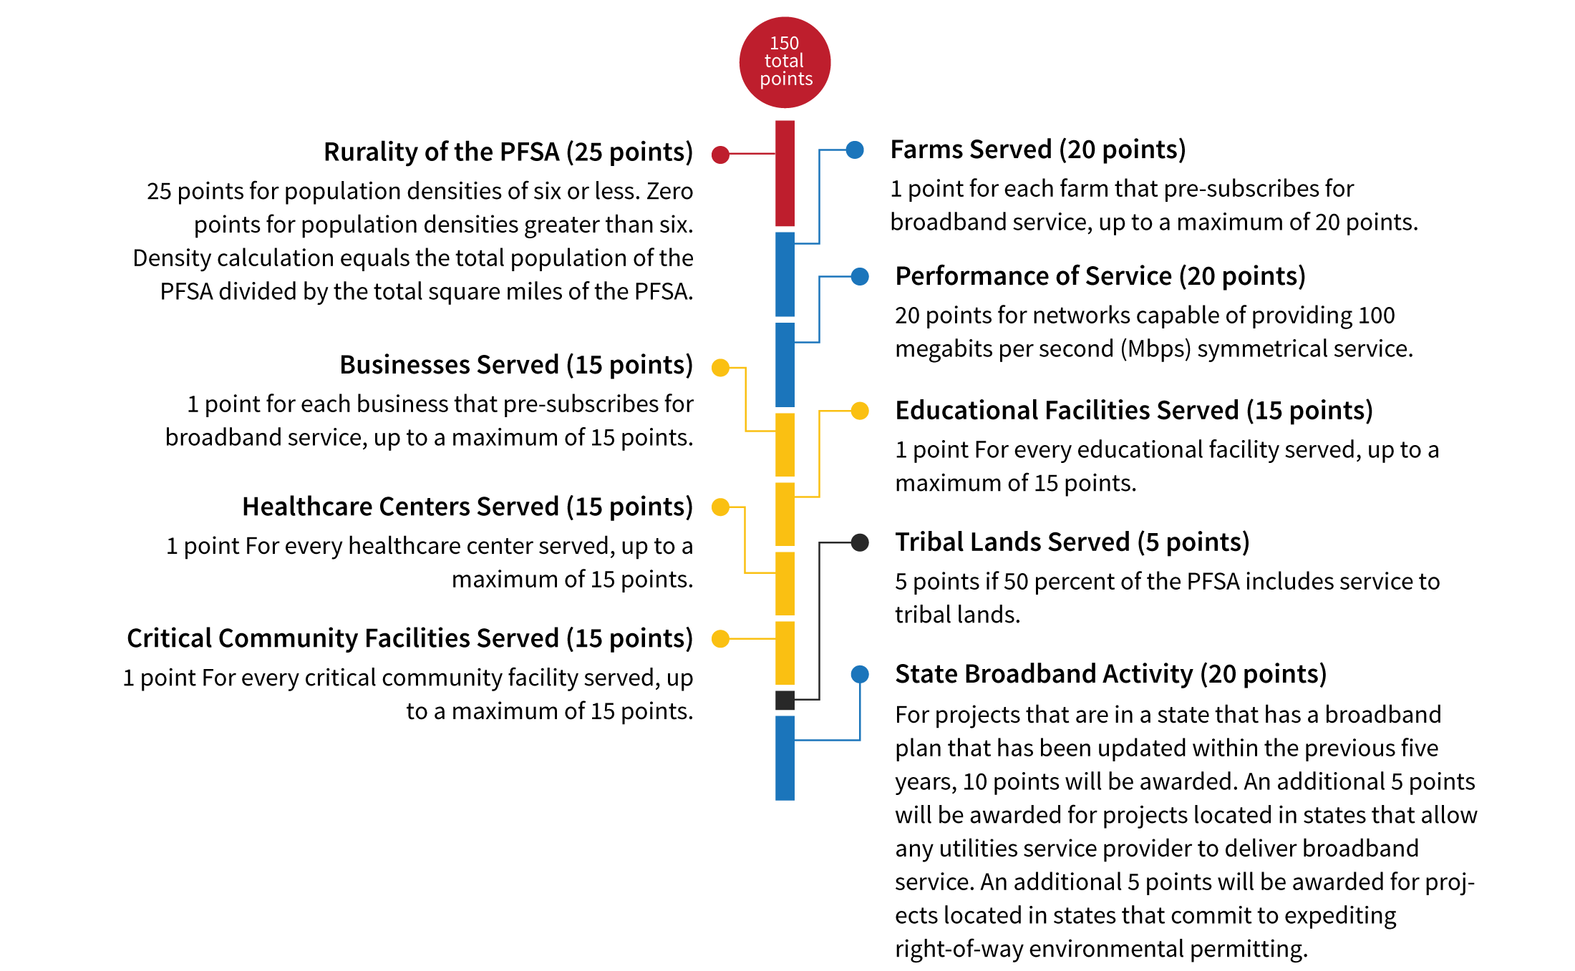

Slide 17
Services Provided by the West Virginia Broadband Enhancement Council
14.
The WVBEC is working to ensure that as many points as possible are available to West Virginia projects under the state broadband activity scoring criteria.
Applicants are required to provide a map of the PFSA to the appropriate State government office, so the State can certify that either funds have or have not been allotted for the area. The WVBEC will perform this certification function in West Virginia.
Notes:
The WVBEC is committed to helping West Virginia projects maximize their opportunity to benefit from the ReConnect Program.
Furthermore, USDA has designated areas that have received state funding to deploy 10:1 service as ineligible for ReConnect funding.

Slide 18
Additional Technical Assistance
15.
USDA is offering technical assistance through webinars and through six regional workshops (time and venue TBD).
Closest proximity to West Virginia in Washington, PA in February 2019.
Recorded webinars and future event announcements are available at reconnect.usda.gov.

Slide 19
WVBroadbandCouncil@wv.gov I broadband.wv.gov
c/o West Virginia Department of Commerce
1900 Kanawha Boulevard East, Building 3, Suite 200 . Charleston, WV 25303

